Slide 1
Get Moving! Instant Activities to Start Your Class
X / Instagram / Facebook: @OPENPhysEd
Presented By: Keith Furstenberg
@ keithfurstenberg74@gmail.com

Slide 2
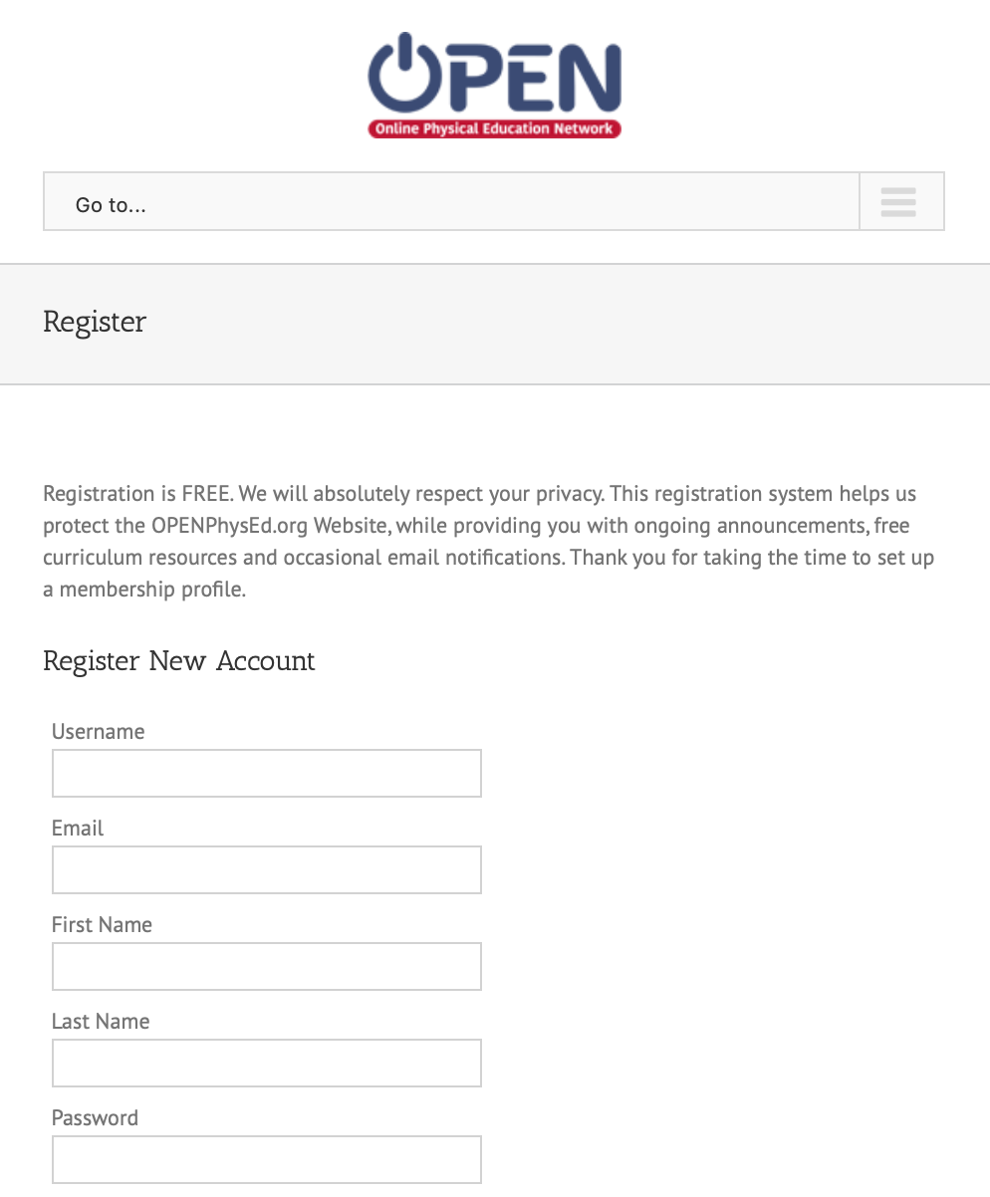
Sign Up for OPEN
Step 1: Visit www.OPENPhysEd.org
Step 2: Select “Register for FREE here”
Step 3: Complete the Form
Step 4: Click “Register”

Slide 3
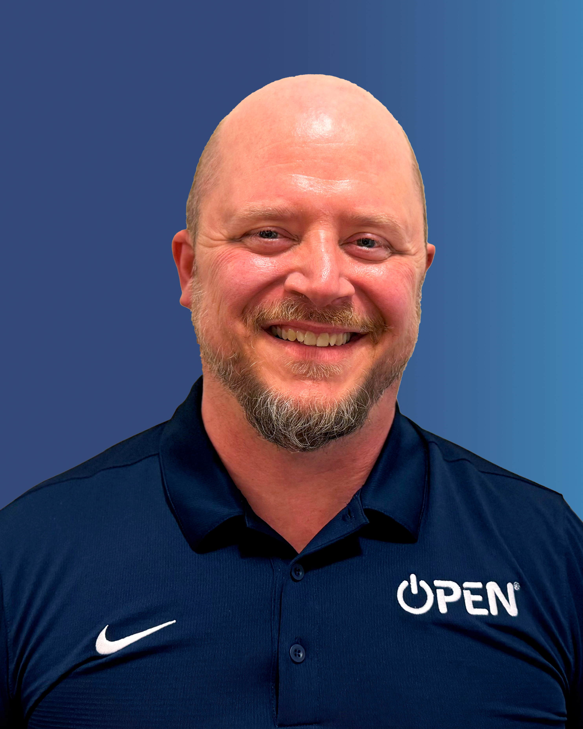
Keith Furstenberg
Educator for 25+ years
Connecting STEM to PE
Create Music
Science Olympiad Coach
OPEN Certified Teacher
Love to travel

Slide 4
Today’s Outcomes:
Connect attendees to OPEN resources.
Provide multiple instant activities for K-12 teachers
Have participants join the OPEN network.
Be creative and share ideas! Know your limits.
Notes:
The perfect PE class is like conducting an orchestra. This professional development uses OPEN content to show teachers how to successfully conduct a class! Participants will review the four pillars of best practices – planning and preparation, classroom environment, instruction, and professional responsibilities. Next, they will learn how to make sure each one is integrated into lesson and program structure to maximize student learning and teacher success! This workshop is designed for a K-12 audience.

Slide 5
Breaking Down An Open Module
All modules include:
Materials List
Activity Plans
Block Plans
Sample Lesson Plan
Academic Language Cards
Skill Cue Cards
Student Assessments
Teacher Reflection Guides

Slide 6
Object of the game is to work with different partners and create a sequence of 4-6 moves
Be creative
My STEM connection is to add animal movements and then discuss and connect some real life animal data
Notes:
Link to BIY Creative Connection Cards activity: https://believeinyou.varsityuniversity.org/wp-content/uploads/2024/05/BIY-Leadership-CreativeConnectionCards-FINAL.pdf

Slide 7
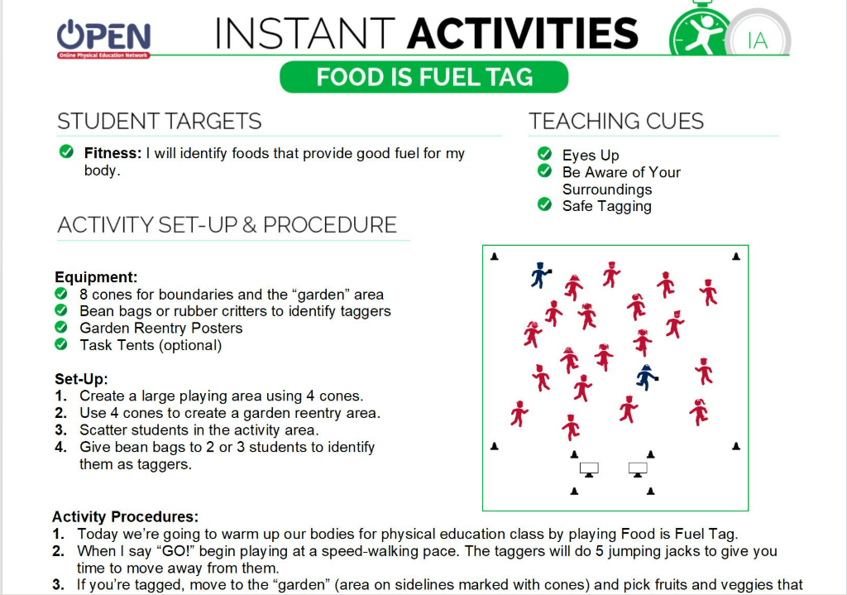
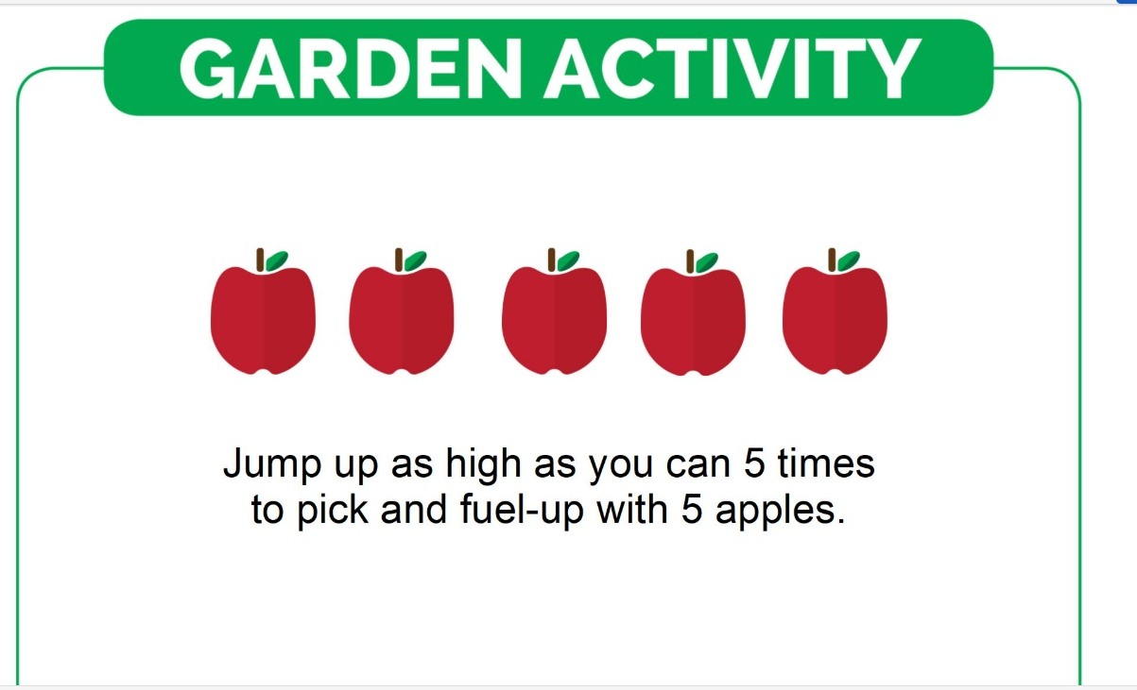
Know your group. For today we will not be doing anything faster than a speed walk.
Print Garden Activity cards from the module.

Slide 8
Notes:
After activity, talk through the discussion questions on this card as a debrief. Remember to link it to teachers making connections with their students and students making connections with their classmates/peers.

Slide 9
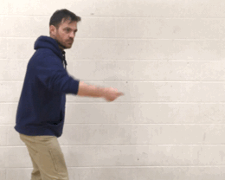
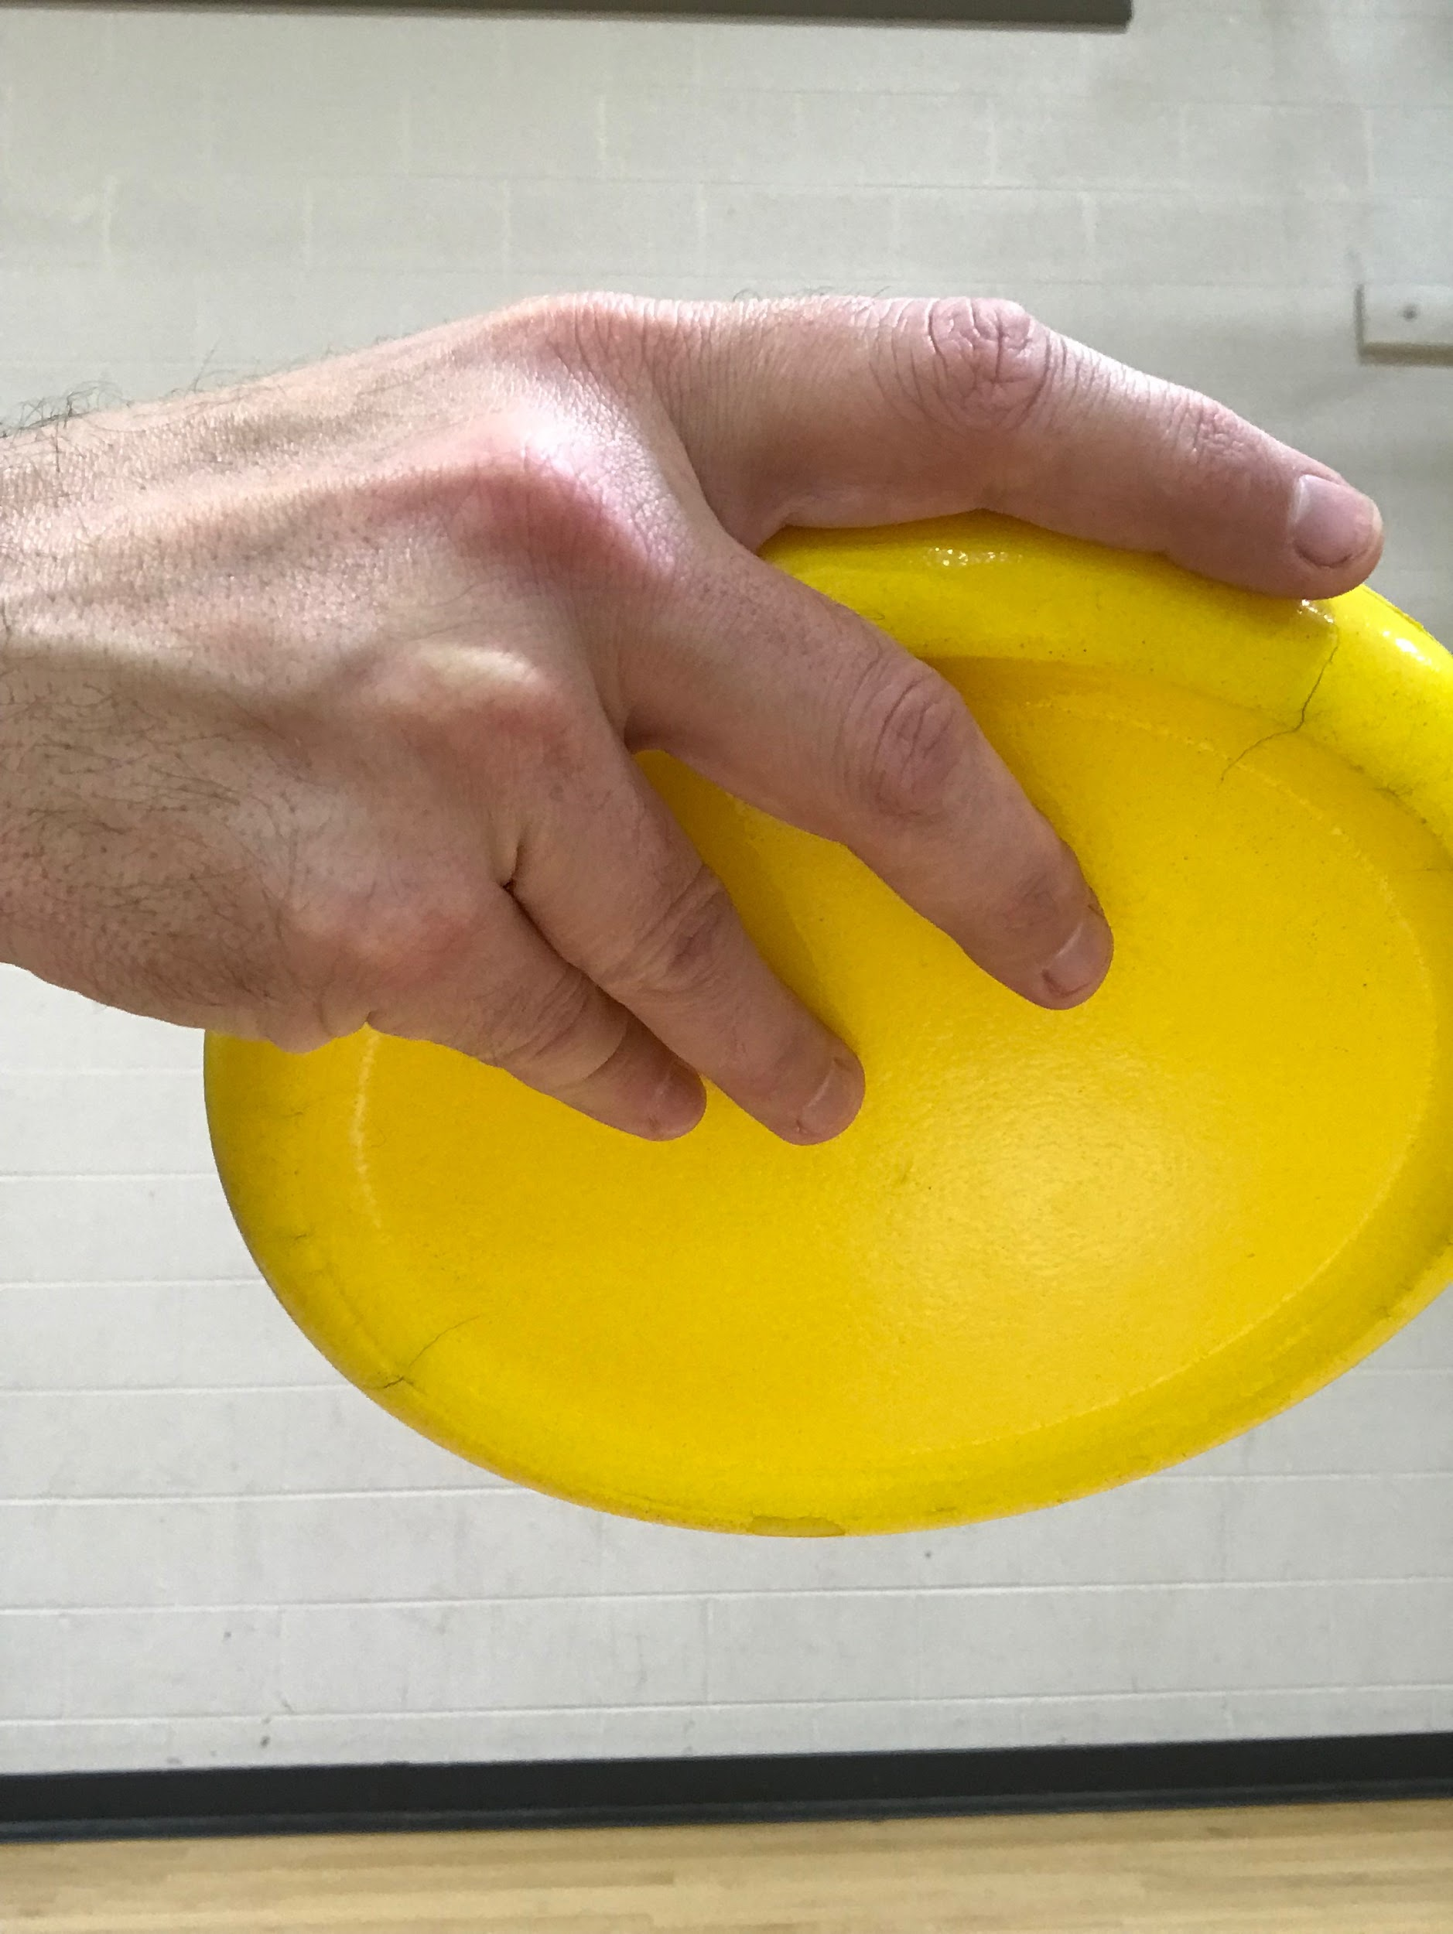
Notes:
Introduce the 4 pillars of best practices with attendees here.

Slide 10
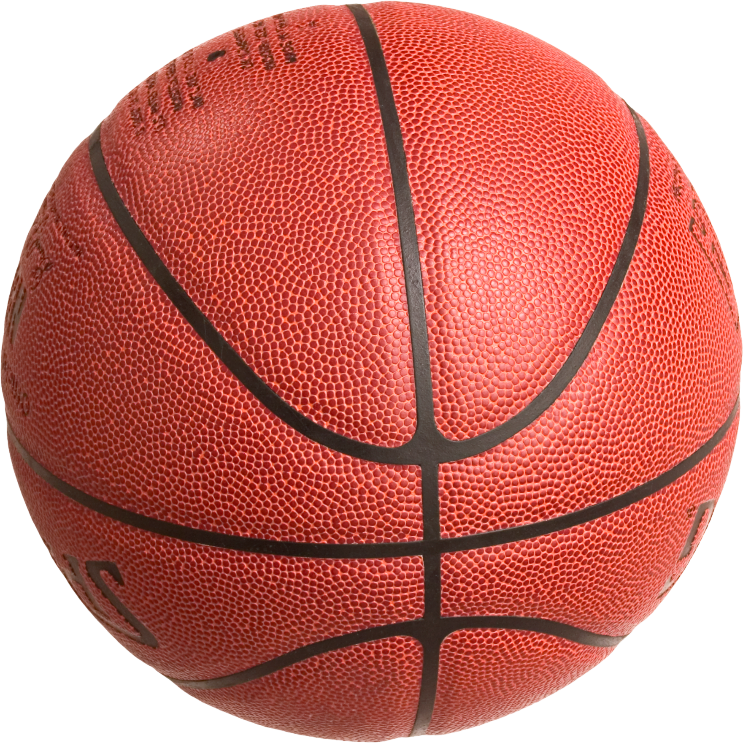
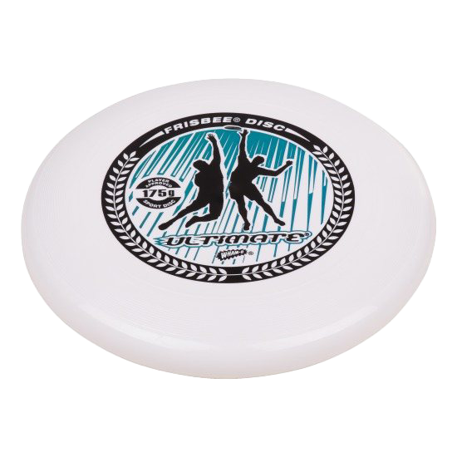
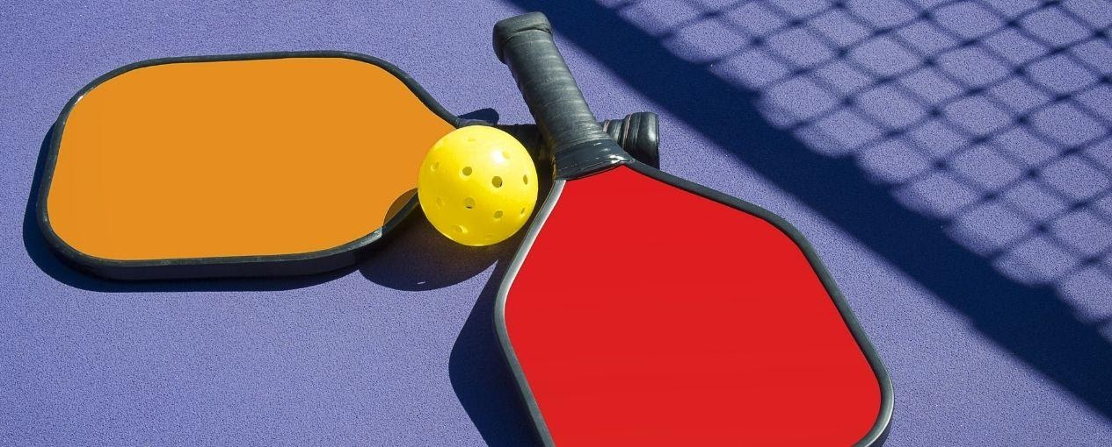
What other skills or modifications can you create?
3, 5, 7
This Photo by Unknown Author is licensed under CC BY-NC-ND

Slide 11
#TeachersHelpingTeachers
Since launching in 2015, we have served:
170,000+ teachers
90 million students
8.6 million downloads
10,000+ resources
$100,000,000 value of free resources

Slide 13
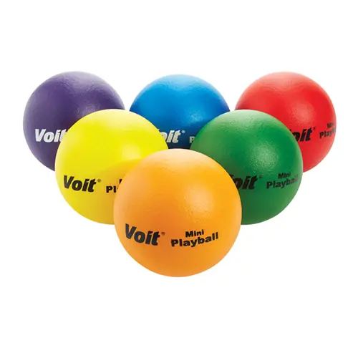
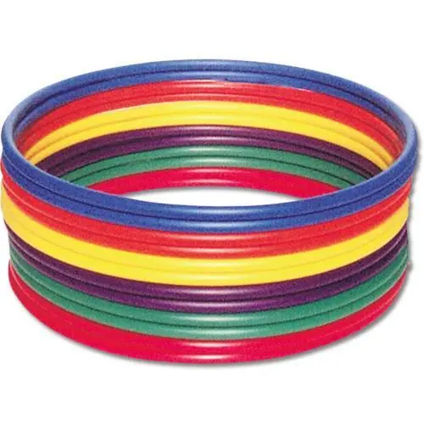
Notes:
Partners- instant activity but challenge other groups- Learn Names- toss, catch, flip hoop if caught

Slide 14
Activity Procedures:
1. It’s time for Partner Flip the Hoop. The object of the game is for you and your partner to move your hoop to the center of the activity area. You’ll do that by tossing the bean bag from the spot marker into the hoop. Every successful toss will get your hoop closer to the center.
2. 1 partner begins as the Tosser, and the other is the flipper. On the start signal, the Tosser tosses the bean bag into the hoop. The Flipper flips the hoop toward the center, picks up the bean bag, and changes places with the Tosser. Continue this way until you make it to the center, then reset and being again.
3. If a toss falls outside of the hoop, the flipper will pick up the ban bag without flipping the hoop before changing places with the tagger.
Notes:
Partners- instant activity but challenge other groups- Learn Names- toss, catch, flip hoop if caught

Slide 15
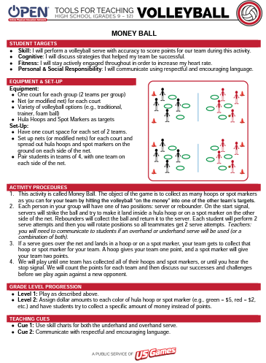
Breaking Down An Activity Plan
All Activity Plans Include:
Student Targets
Activity Set-Up & Procedure
Teaching Cues
Grade-level Progressions
Easy to Follow Diagram
Universal Design for Learning
Suggested Academic Language
Tiered-Questioning (DOK)

Slide 16
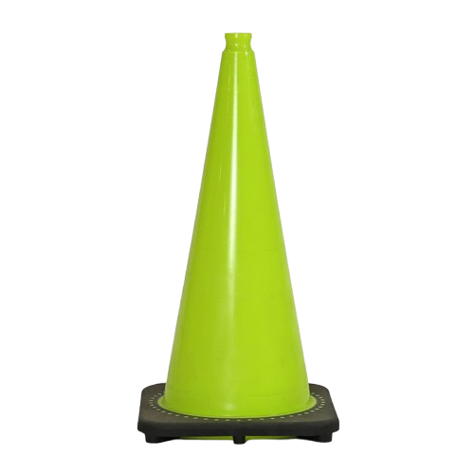
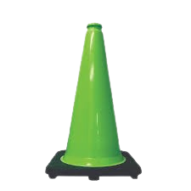
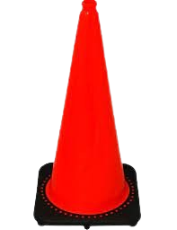
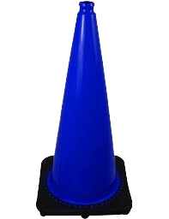
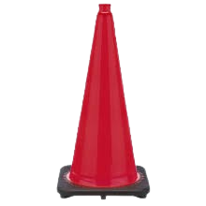
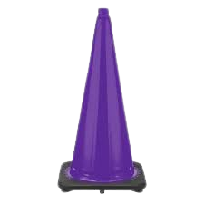
Activity Procedures:
1. We’re going practice our throwing and catching with a game called Johnny on the Spot. The object is to collect as many spots as you can by making a clean catch while standing on a spot.
2. On the start signal, the partner with the ball stays in the home hoop while the other partner travels safely to any spot.
3. The partner in the hoop will throw the ball to the partner on the spot. If she/he catches it, she/he’ll throw it back to the hoop partner.
4. If both partners catch the ball, they get to keep the spot. Pick it up and place it in your home hoop, and then change roles and continue playing, working to collect as many spots as possible.
Notes:
another good instant activity- partner/group challenge- race other groups 6 teams (to prep for capture the corner)

Slide 17
MINUTE TO WIN!
Growth mindset is developed through experience, struggle, failure,
and triumph.
Minute to Win challenges are designed to be a safe place for students to experience and understand this journey. This module offers students fun team-based activities that will help them set a baseline performance and then actively engage to grow and improve.

Slide 18
CONE CATCHER
The object of the game is for your team to use the cone to catch as many beanbags as you can in 1 minute.
Cone Catcher [PDF, WORD]
Notes:
Rotations, Teamwork, taking turns.
Growth Mindset Question Set:
DOK 1: What are some words that you can think of that are related to growth mindset?
DOK 2: How does growth mindset apply to practicing Minute To Win challenges?
DOK 3: How can you apply growth mindset to other areas of your life?
Teamwork Question Set:
DOK 1: What is teamwork? What does it look like? What does it sound like?
DOK 2: How does teamwork affect how well your team performs in Minute to Win challenges?
DOK 3: How does growth mindset affect how well you work with a team?

Slide 19
HOOP IT UP!
The object of this game is to toss the beanbag through the hoop as many times as you can in 1 minute. However, for a toss to count, the beanbag cannot hit the floor. It has to be caught by a teammate before hitting the ground.
Hoop It Up [PDF, WORD]
Notes:
DOK 1: What is a challenge? Can you give examples of a challenge that someone might face?
DOK 2: How would you apply growth mindset to facing a challenge?
DOK 3: Describe what someone might learn from facing a difficult challenge

Slide 20
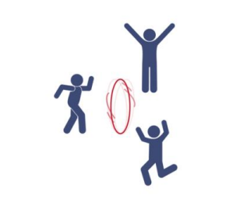
SPINNER WINNER
The object of the game is to spin your team’s hoop like a coin for as long as you can and end up with the fewest number of spins in 1 minute as possible.
How can you modify this game?
Spinner Winner [PDF, WORD]
Notes:
DOK 1: Can you list positive and encouraging words that could be used to give someone feedback?
DOK 2: Can you give an example of using positive communication to give feedback to a teammate?
DOK 3: Can you predict how you’d react to a teammate who gave you feedback using positive communication versus someone who used negative language and communication?

Slide 21
HOOP TOSS
The object of the game is for your team to toss and land your hoop onto the cone as many times as you can in 1 minute.
Hoop Toss [PDF, WORD]
Notes:
DOK 1: How can you recognize a coachable teammate?
DOK 2: What is something that you can do to be more coachable?
DOK 3: How is being coachable related to being a good teammate?

Slide 22
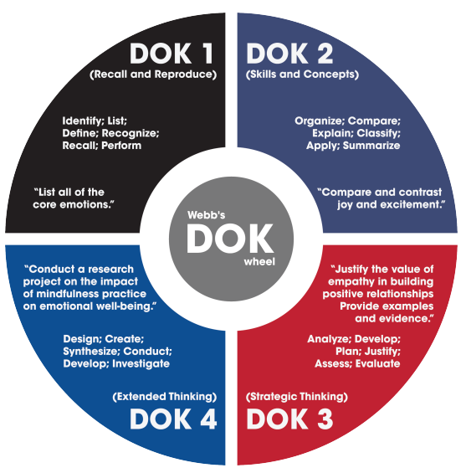
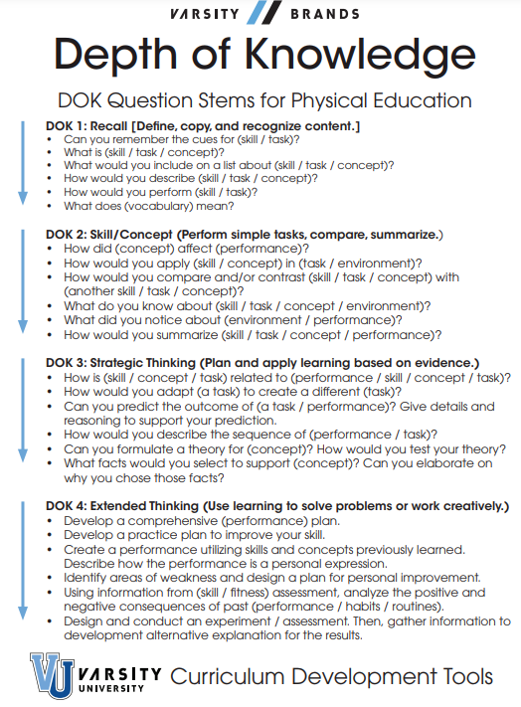
DEPTH OF KNOWLEDGE RESOURCES
DOK Wheel & Question Stems: [PDF] DOK Question Set Gen GPT: [CLICK HERE]

Slide 23
BUILDING SKILLS WITH ACADEMIC LANGUAGE
ACADEMIC LANGUAGE RESOURCES
Academic Language List GPT: [CLICK HERE]
Notes:
Show attendees the ChatGPT Aaron created as a resource.

Slide 24
School-Wide Event Resources
Field Days [CLICK HERE] Kids Heart Challenge [CLICK HERE] Family PE Week [CLICK HERE] Host a Family PE Night [CLICK HERE] Student Empowerment Month [CLICK HERE] Look For the Good Project [CLICK HERE] National PE & Sport Week [CLICK HERE]
Advocacy Resources
Program Introduction Letter [WORD] Family PE Week Invitation [WORD] Physical Education Letterhead Image [PNG] SHAPE America [CLICK HERE] National Academy of Health & Physical Literacy [CLICK HERE] Active Schools [CLICK HERE] CDC [CLICK HERE] Action for Healthy Kids [CLICK HERE]
Notes:
pecat
family PE week
Currculum Maps

Slide 25
Reflection & Debrief
Share any of the following:
3 Things I learned
2 Things I want to try
1 Question I still have

Slide 26
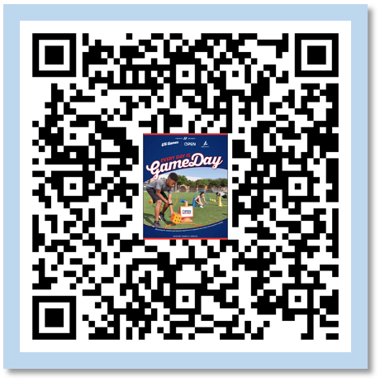
BSN SPORTS/US Games
Your US Games/ BSN SPORTS Rep is
waiting to serve you.
Email: USGames@bsnsports.com
SCAN HERE for our Catalog

Slide 27
Comments and Questions
Contact Information:
Keith Furstenberg
@coachfurstenberg on Instagram
@FreeHomeRocket on Twitter/X
Keithfurstenberg74@gmail.com
This Photo by Unknown Author is licensed under CC BY

Slide 28
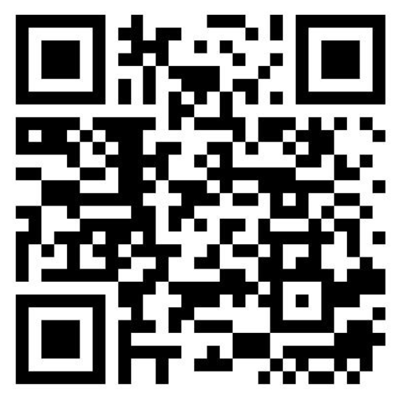
Complete our online evaluation at
www.bit.ly/OPENPD

